Slide 1
Microservices, Event-Driven, CQRS & Event Sourcing
Guido Schmutz (guido.schmutz@trivadis.com)
gschmutz
http://guidoschmutz.wordpress.com

Slide 2
Microservices Architecture Capabilities (wip)
Data Catalog
Service Discovery & Registration
Tracing
Test Management
Container Orchestration
Authentication
Load Blancing
Logging
Test Automation
Authorization
Circuit Breaker
Observability
Message Broker
Dependency Configuration
Message Encryption
Messaging
Health Checks
Event Hub
Properties Configuration
Event Streaming
Message Retries
Event Store
CQRS
Service Failover
NoSQL Storage
Data Model
Staged Rollouts with %-based traffic split
Event Sourcing
Fault Injection
RDBMS Storage
Message Format
Versioning
API Catalog
Message Routing
In-Memory Storage
Message Protocol
Rollback of Rollout
Data Flow
Fault Tolerance
Object Storage
Rate Limitation / Throttling
Message Transformation
Config Hot Updates

Slide 3





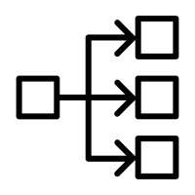










Security
Service Governance
Identity
Provider
Security
Token
API Catalog
Service Registry
Service Discovery
Backing Services
Apps
External Gateway
Microservice Platform
Persistence
Config Store
Mobile App
Event Store
Microservice A
API Gateway
Service
Routing
Load
Balancing
Browser App
Messaging
Microservice B
Other Service
Self Heal
Auto Scale
Event Hub
Dev/Ops Automation
Telemetry
Build
Automation
Test
Automation
Image
Repository
Deployment
Automation
Platform
Automation
Monitoring
Diagnostics

Slide 4
Security
Service Governance
Micro
Architecture
Makro
Architecture
Identity
Provider
Security
Token
API Catalog
Service Registry
Service Discovery
Backing Services
Apps
External Gateway
Microservice Platform
Persistence
Config Store
Mobile App
Event Store
Microservice A
API Gateway
Service
Routing
Load
Balancing
Browser App
Messaging
Microservice B
Other Service
Self Heal
Auto Scale
Event Hub
Dev/Ops Automation
Telemetry
Build
Automation
Test
Automation
Image
Repository
Deployment
Automation
Platform
Automation
Monitoring
Diagnostics

Slide 5
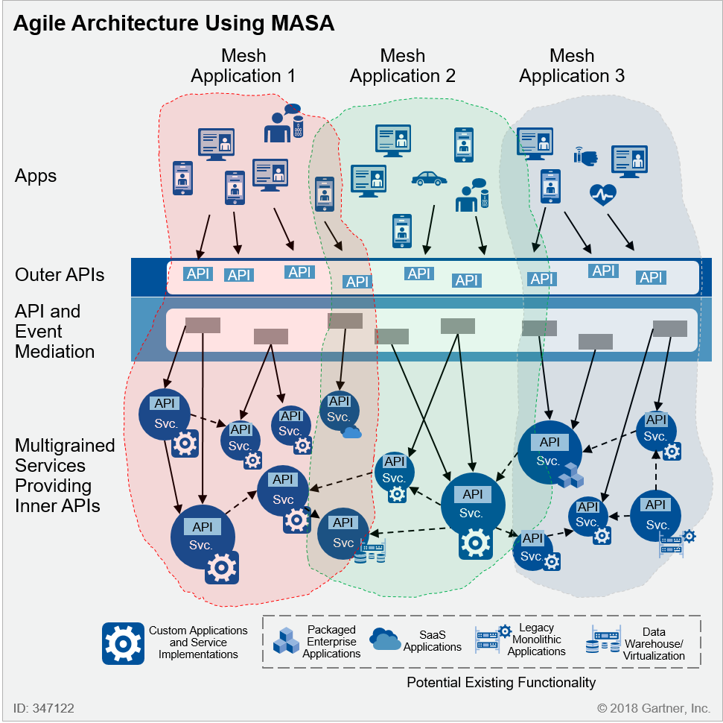
Mesh app and service architecture (MASA)

Slide 6
Hexagonal Architecture (a.k.a. Ports and Adapters)
Primary/Driving Adapters
Secondary/Driven Adapters
Port
API
Adapter
REST
{ }
Business
Logic
Event Hub
Web UI
Database
Application
Domain
Infrastructure

Slide 7
Hexagonal Architecture for Domain Driven Design
Port
API
Adapter
REST
{ }
Event Hub
Domain
Web UI
Database

Slide 8
Hexagonal Architecture
Security
Transactions Task Coordination
Use Case Controller
API
Security
User Interface
Representations
Entities
Business Logic
Domain Events
Repositories
Documents
Cache
Messaging
REST
{ }
Database
Web UI
Input Adapter
Application Service
Domain Service
Output Adapter
Event Hub
Persistence
Domain Events
Event Hub
Domain Events

Slide 9
Pattern: Synchronous Request Response
Microservice A
Microservice B
REST
REST

Slide 10
Pattern: Event Interaction
Microservice A
Microservice B
Producer
Event Hub
Consumer

Slide 11
Pattern: CQRS
Consumer
A
Producer
Event Hub
B
Writer
Consumer
Writer
Database
Database
Dual Writer Problem
nicht existierend wenn XA Transaktionen genutzt werden
”eat your own dog food” – Event First und Konsumieren des eigenen Events und dann schreiben in DB
Outbox Pattern
Notes:
Dual Writer Problem
nicht existierend wenn XA Transaktionen genutzt werden
”eat your own dog food” – Event First und Konsumieren des eigenen Events und dann schreiben in DB
Outbox Pattern

Slide 12

Hybrid Scenario
On-Premises
Cloud
Microservice A
Microservice B
Event Hub
Mirroring
Event Hub
Producer
Data Flow
Consumer

Slide 13
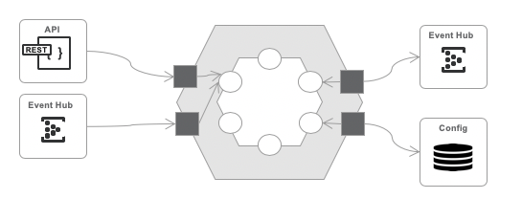
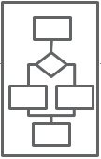
Pattern: Orchestration
Domain
Local
Process Engine
Microservice A
Microservice A
Microservice B

Slide 14
1 Datenpipeline with N Teams
eine zentrale Datenpipeline mit einem ”zentralen” Betrieb
nur ein Deployment und eine Entwicklung des Codes
Pipeline wird zu Infrastruktur mit Release Upgrade Problematik (Risiko)
Team-spezifikas werden über Konfiguration gemacht
man baut sich einen Custom ESB mit allen Nachteilen
Infrastruktur
A
B

Slide 15
N Datenpipelines mit N Teams
Jedes Team hat seine eigene Datenpipelines, die es auch betreibt
gemeinsame Logik wird als Shared Kernel ausgeliefert
Betrieb von parallelen Version vom Shared Kernel möglich => Jedes Team ist selbst für Upgrade verantwortlich
Shared Kernel Möglichkeiten
Library (JAR)
Spring Boot Application
Docker Image
zentrale Entwicklung von Shared Kernel bleibt (Infrastruktur)
Microservice A
Microservice B

Slide 16
Hexagonal Architecture (a.k.a. Ports and Adapters)
API
Event Hub
REST
{ }
Event Hub
Config

Slide 17
Hexagonal Architecture (a.k.a. Ports and Adapters)
API
Event Hub
REST
{ }
Event Hub
Config

Slide 18
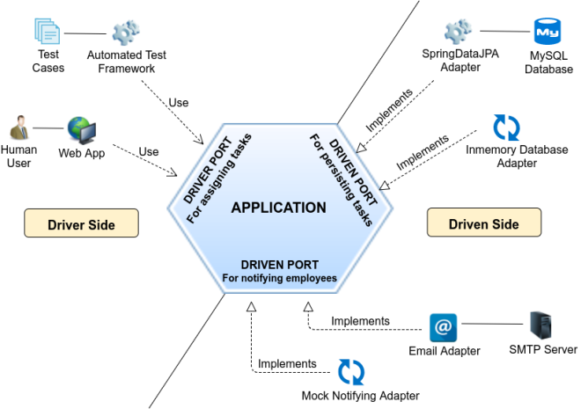
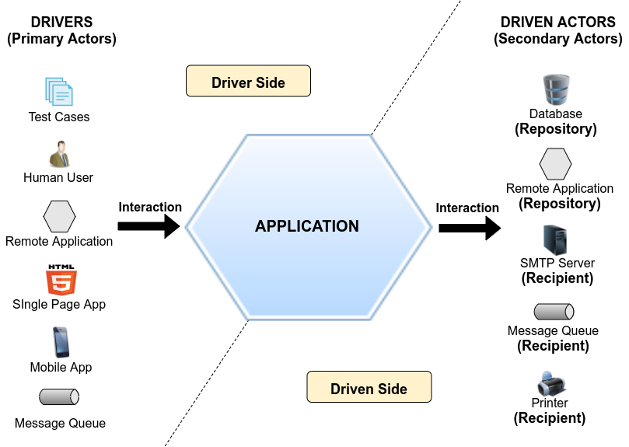
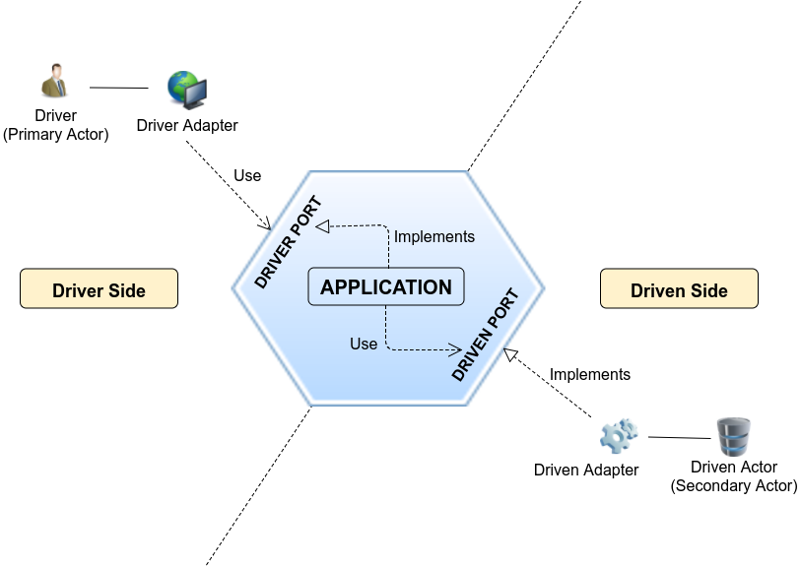

Slide 19
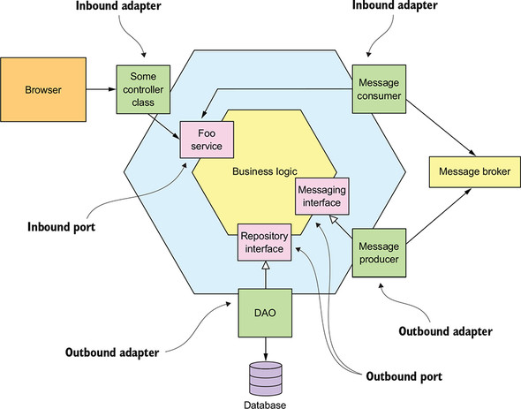

Slide 20
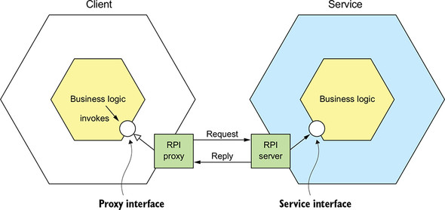
Remote Procedure Invocation

Slide 21
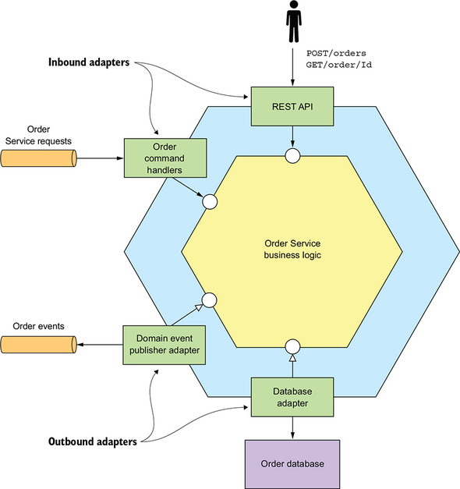
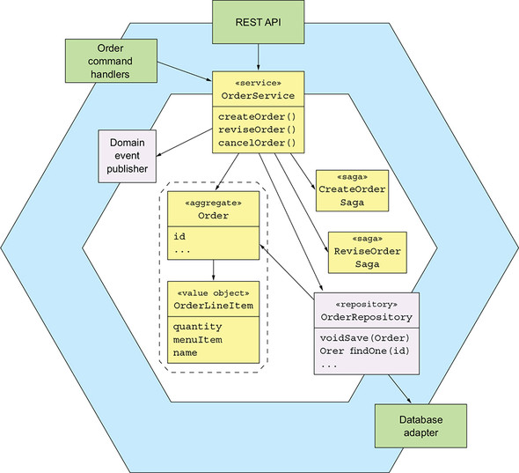

Slide 22
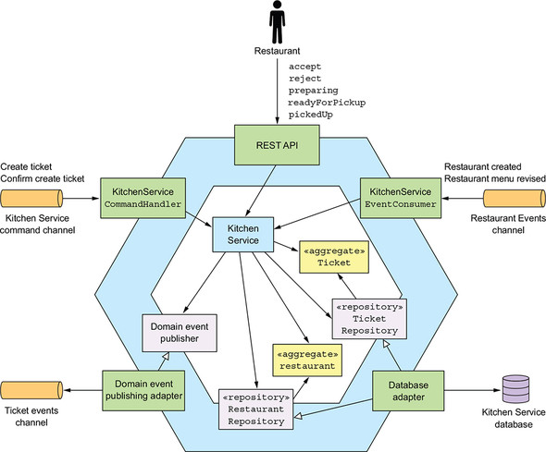
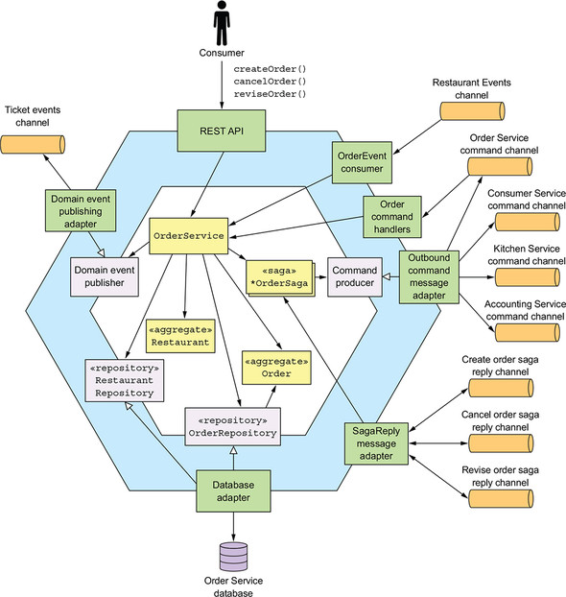

Slide 23
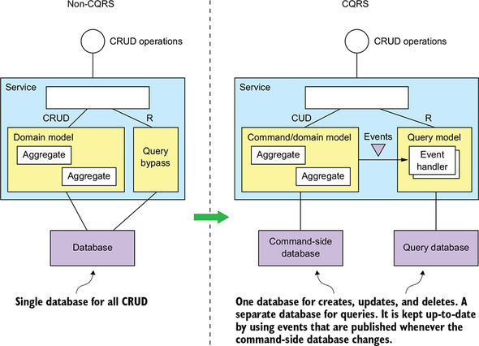

Slide 24
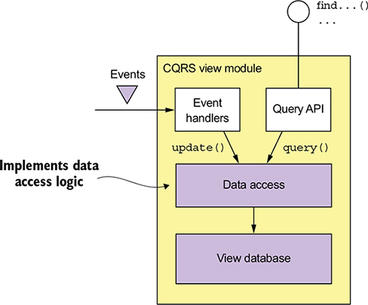
CQRS

Slide 25
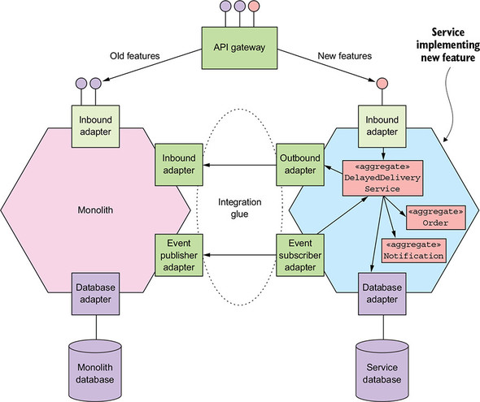

Slide 26
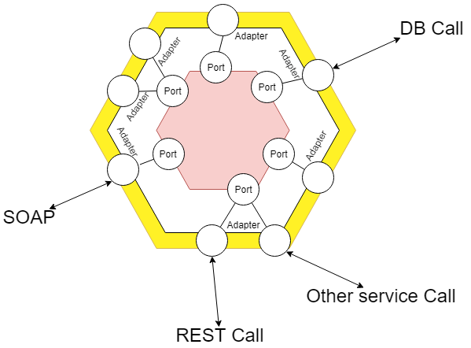

Slide 27
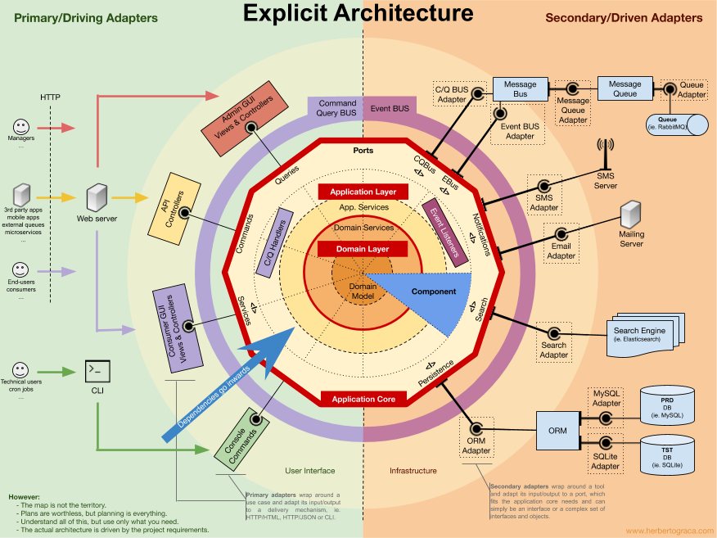

Slide 28
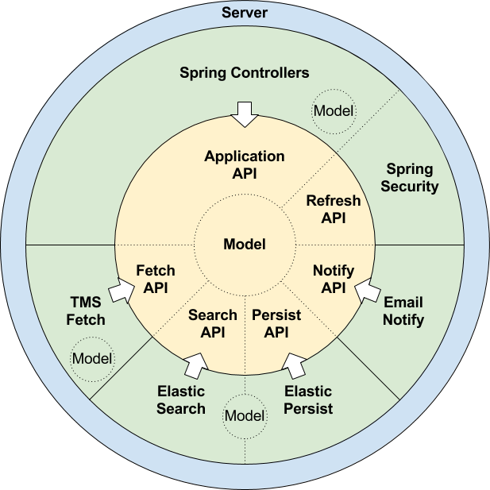

Slide 29
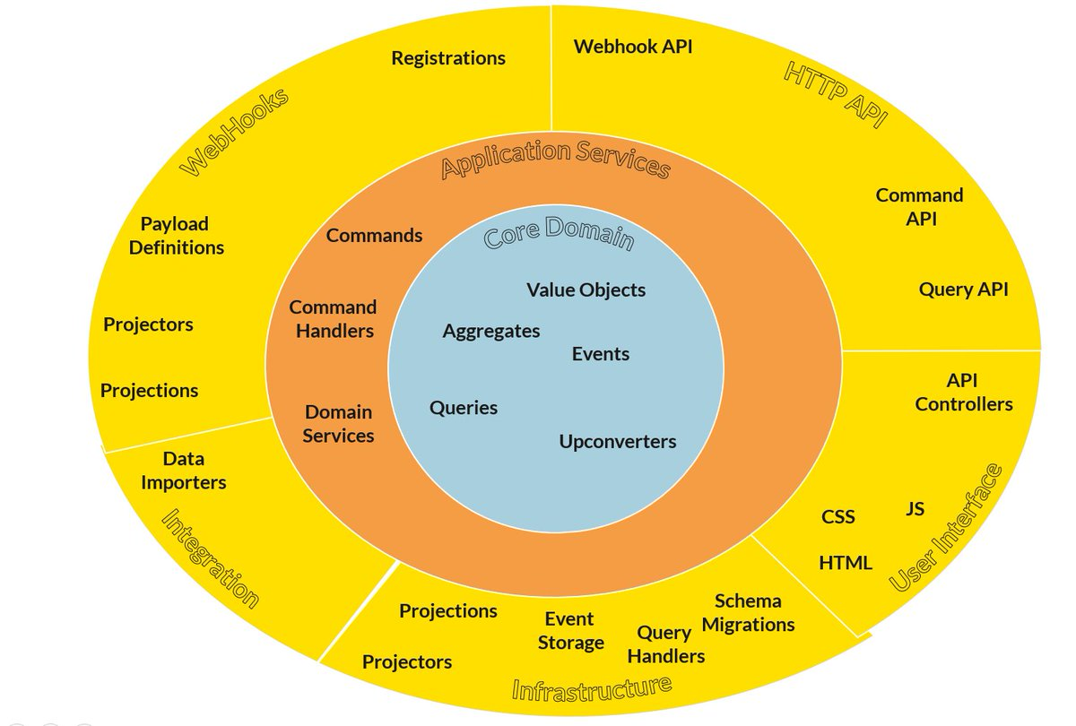

Slide 30
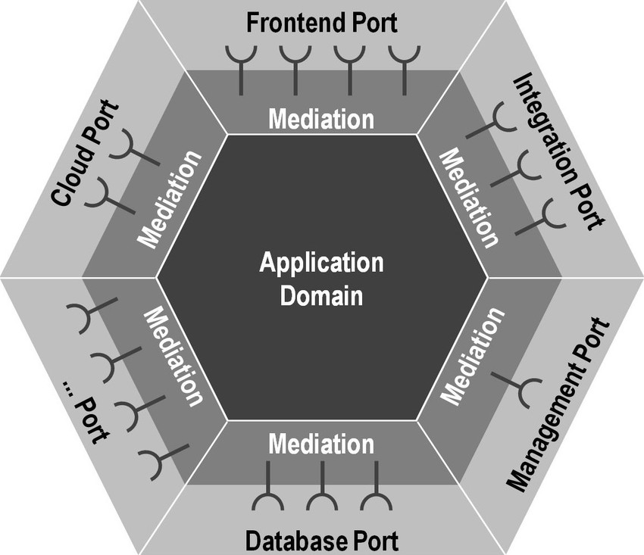

Slide 31
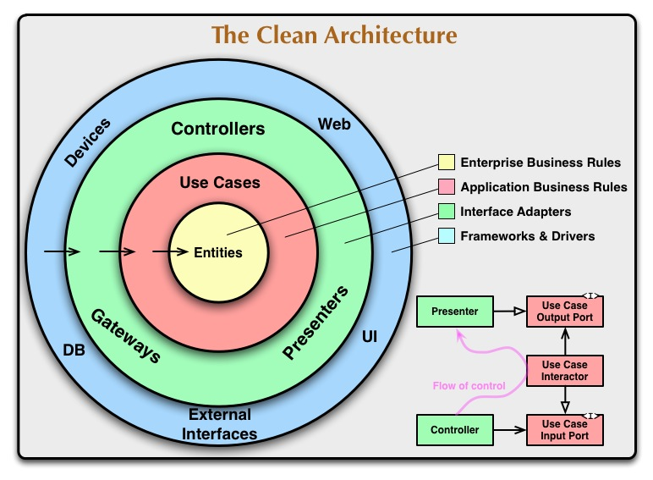

Slide 32
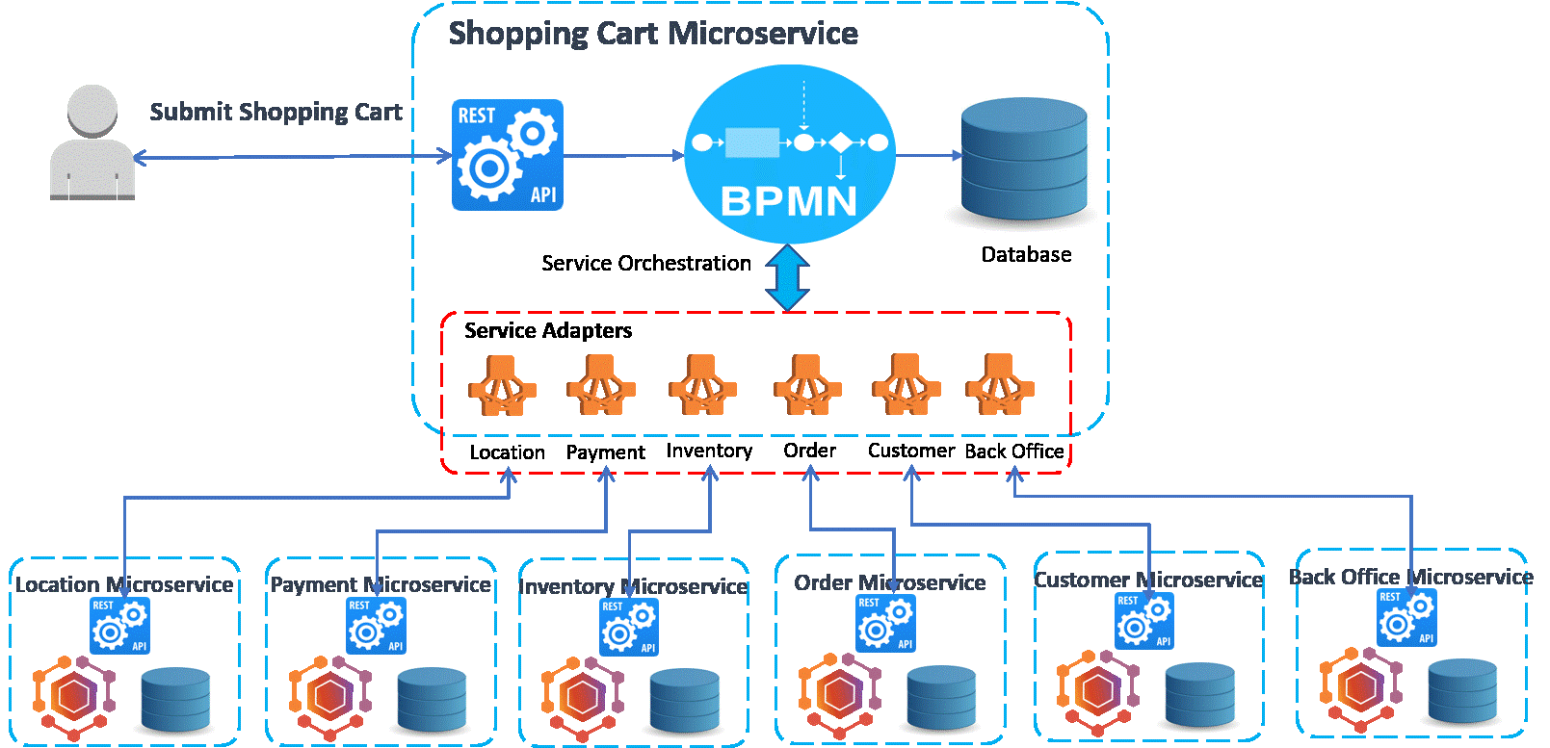

Slide 33
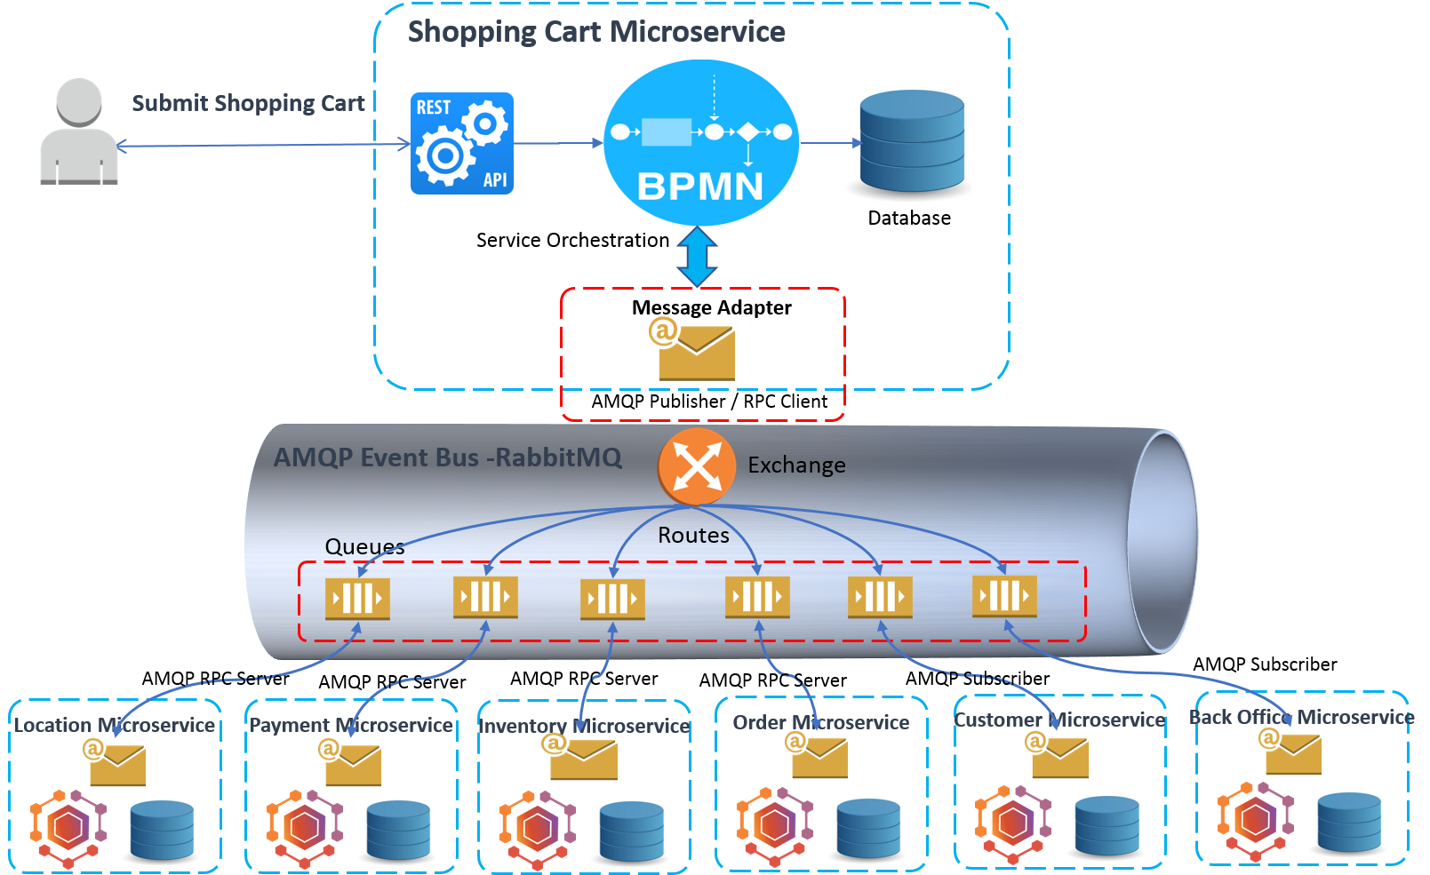

Slide 34
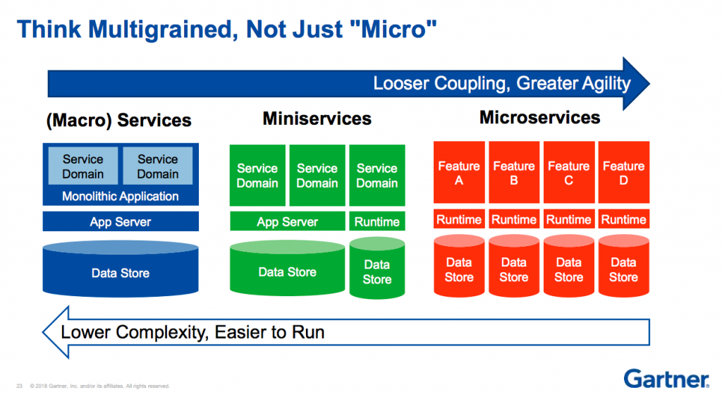

Slide 35
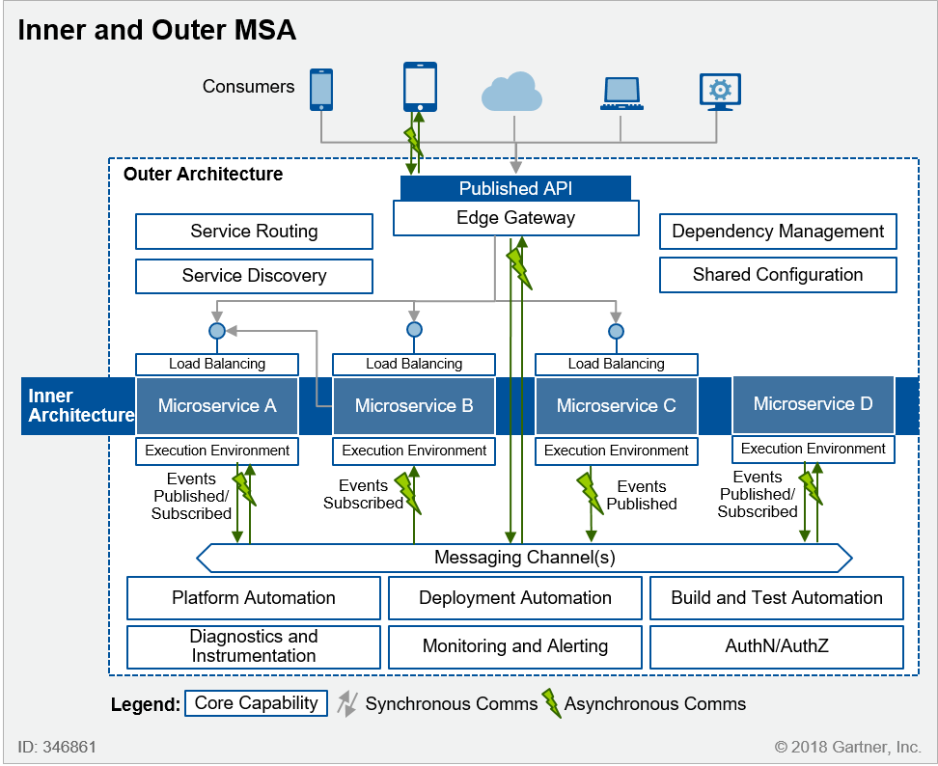

Slide 36
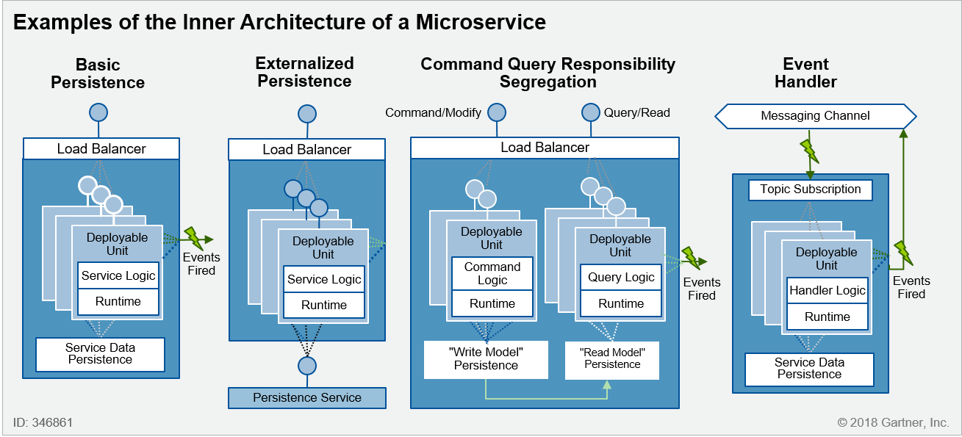
Example of Inner Architecture of a Microservice

Slide 37
